Slide 1
Elliptic curve Diffie Hellmen (ECDH) Key exchange Algorithm

Slide 2
Elliptic curve Diffie Hellmen (ECDH) Key exchange
The Diffie-Hellman algorithm is being used to establish a shared secret that can be used for secret communications using the elliptic curve.
Let us consider 4 variables, one prime P and G (generator) and two private values a and b.
P and G are both publicly available.
Users (say Alice and Bob) pick private values a and b and they generate a key and exchange it publicly.
The opposite person receives the key and that generates a secret key, after which they have the same secret key to encrypt.

Slide 3
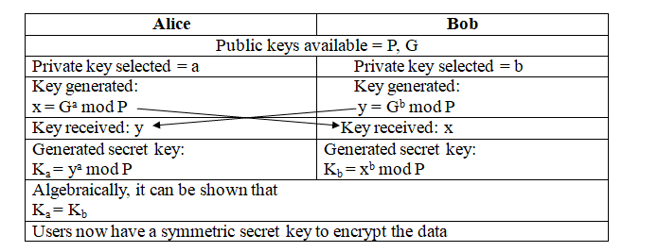
Steps involved in ECDH algorithm

Slide 4
Example
Step 1: Alice and Bob get public numbers P = 23, G = 9
Step 2: Alice selected a private key a = 4 and Bob selected a private key b = 3
Step 3: Alice and Bob compute public values
Alice: x = (Gª mod P) =(9⁴ mod 23) = (6561 mod 23) = 6
Bob: y = (G^{b} mod P) = (729 mod 23) = 16
Step 4: Alice and Bob exchange public numbers
Step 5: Alice receives public key y =16 and Bob receives public key x = 6
Step 6: Alice and Bob compute symmetric keys
Alice: ka = yª mod P = 16⁴ mod 23 = 65536 mod 23 = 9
Bob: kb = x^{b} mod P = 6³ mod 23 = 216 mod 23 = 9
Step 7: 9 is the shared secret key.

Slide 5
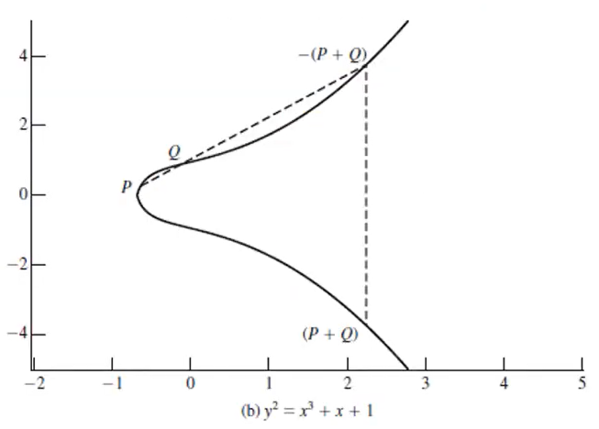

Slide 6
Exercises
1. If P = (13,7) ∈E₂₃(1,1) then find – P.
Solution:
NOTE: if P = (x1,y1) then – P = (x1,-y1)
-P = (13,-7)
Where – 7 mod 23 = 23 – (7 mod 23) = 23 – 7= 16
So, -P = (13,16)
Notes:
https://www.youtube.com/watch?v=3AmkQjdiW7o

Slide 7
2. Consider an EC point G = {15, 13} on the elliptic curve over finite field y2 ≡ x3 + 7 (mod 17) and multiply it by k = 6. Find P = kG.
Hint: 2P = P + P, 3P = P + 2P, 4P = P + 3P,…….
Solution:
P = kG = 6 * (15,13) = (5, 8)

